Slide 1


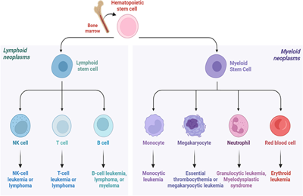
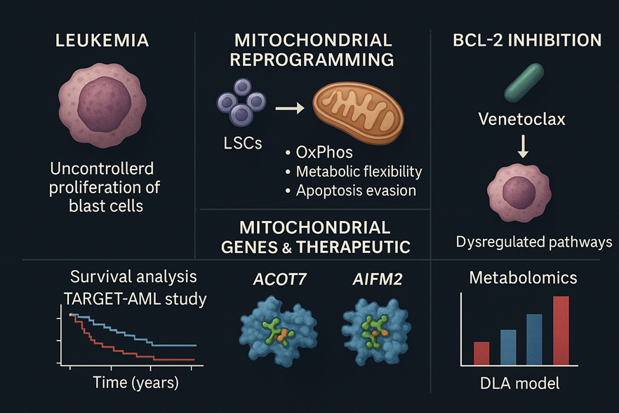
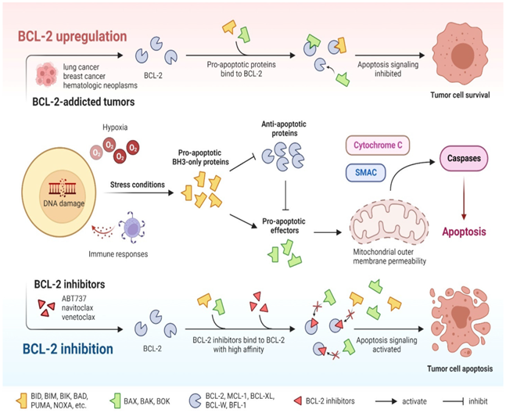
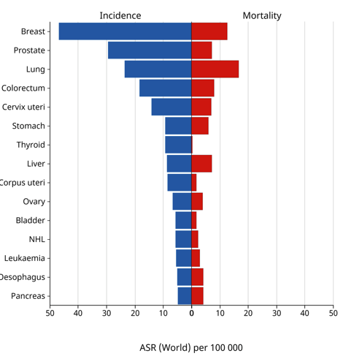
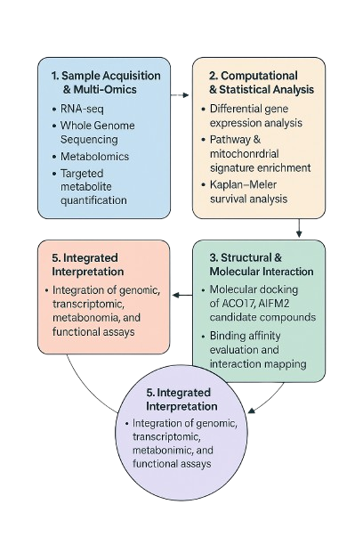
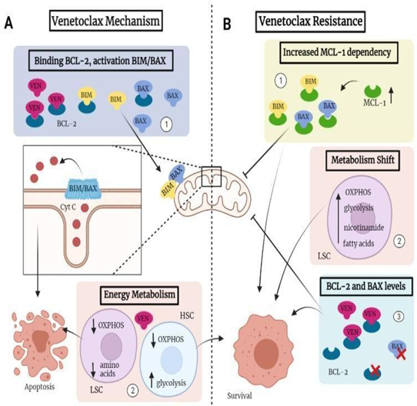
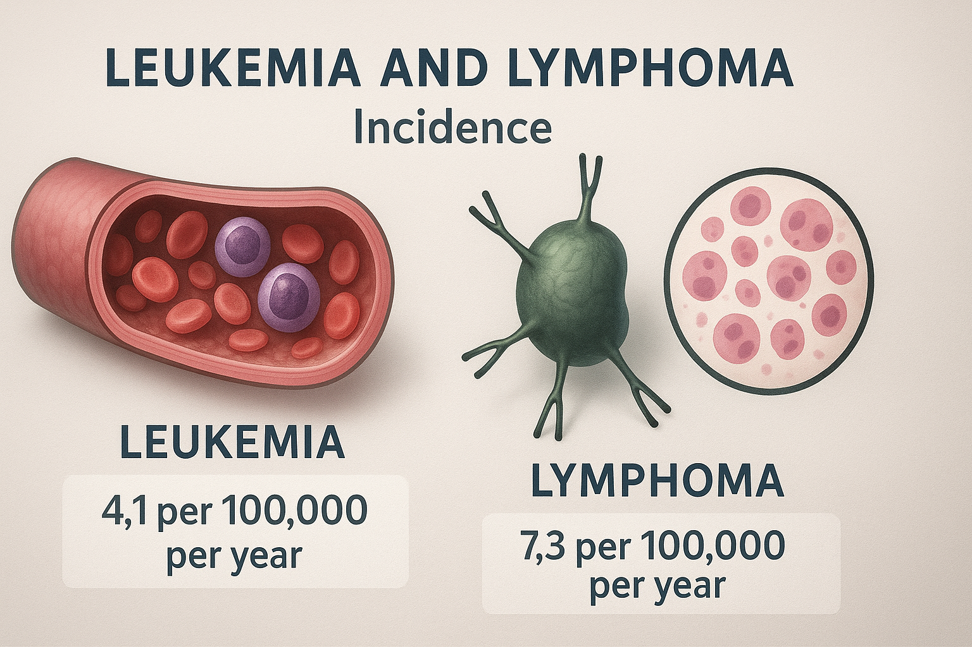
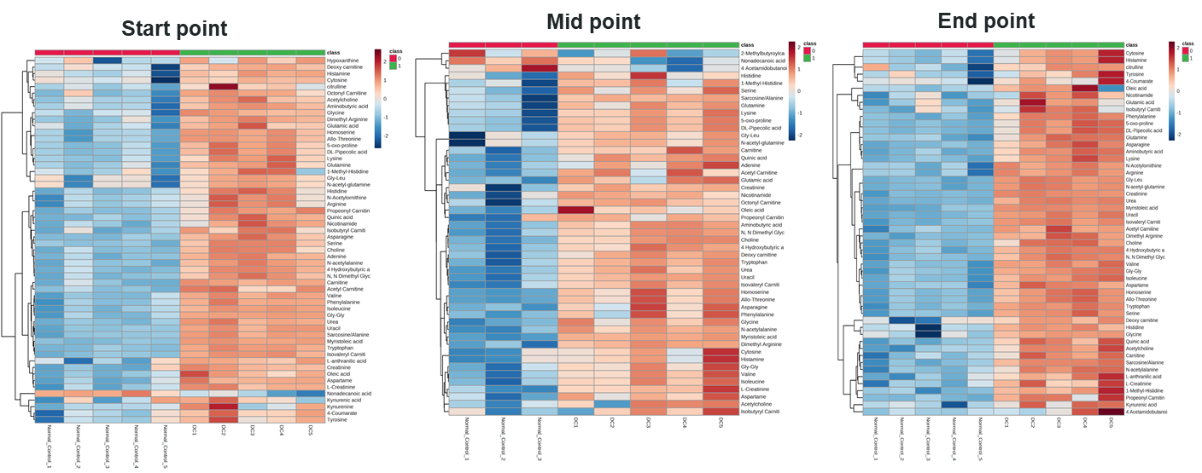
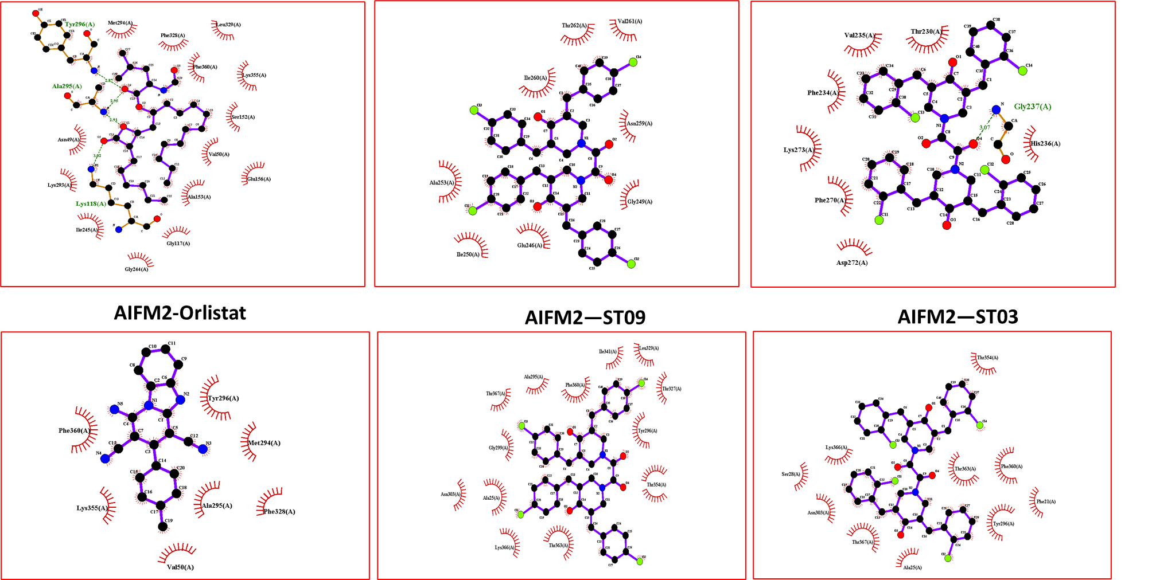
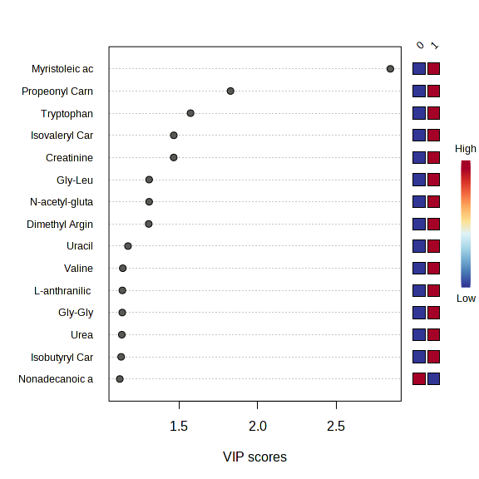
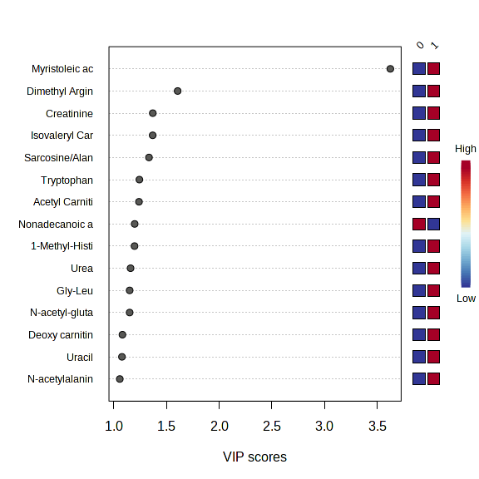
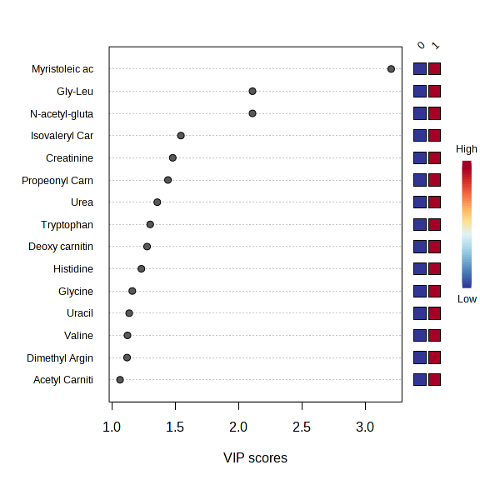
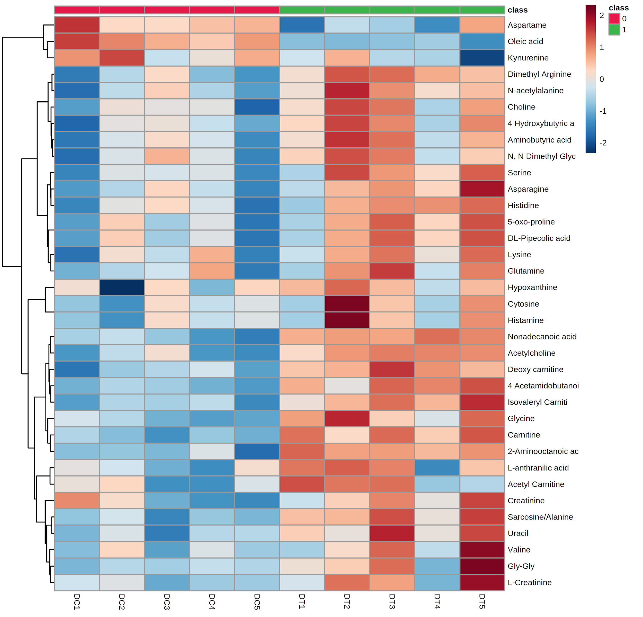
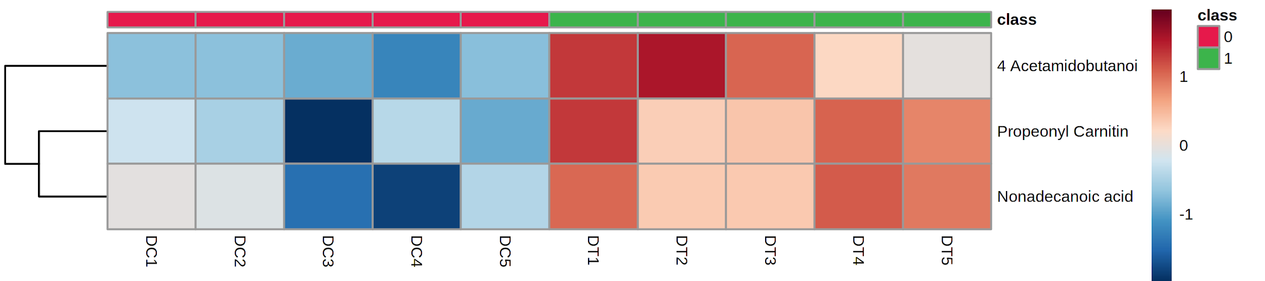
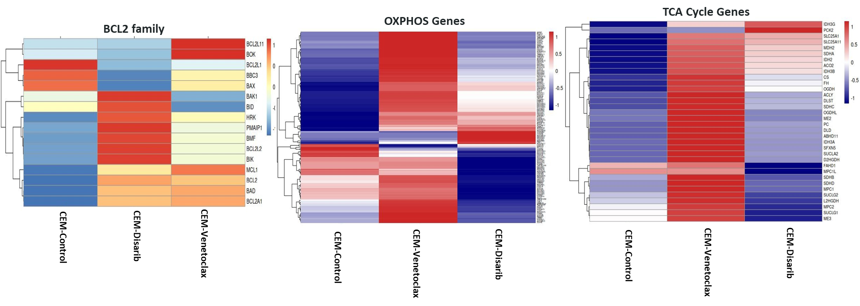
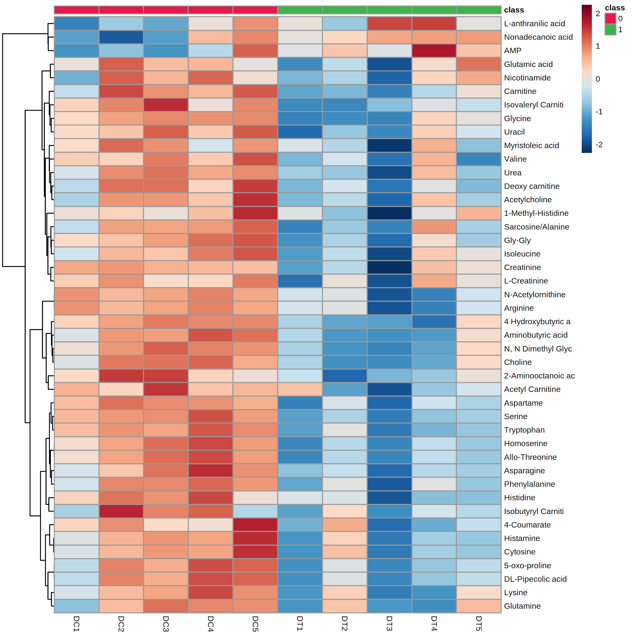
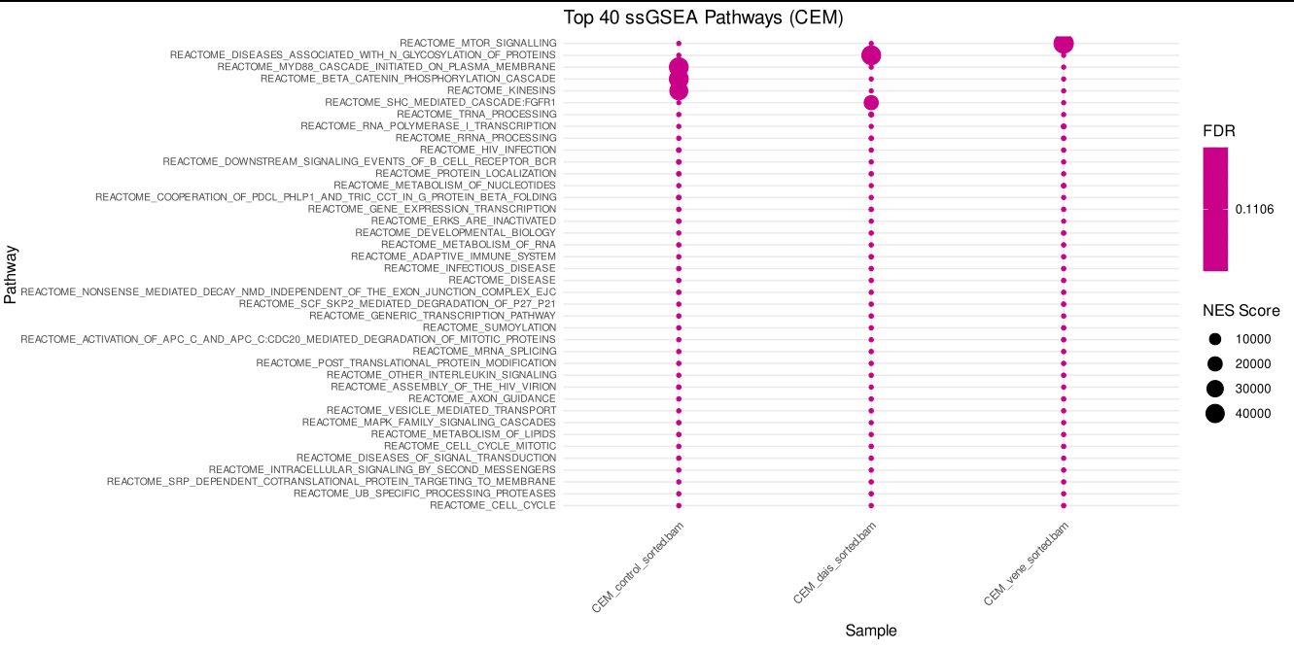
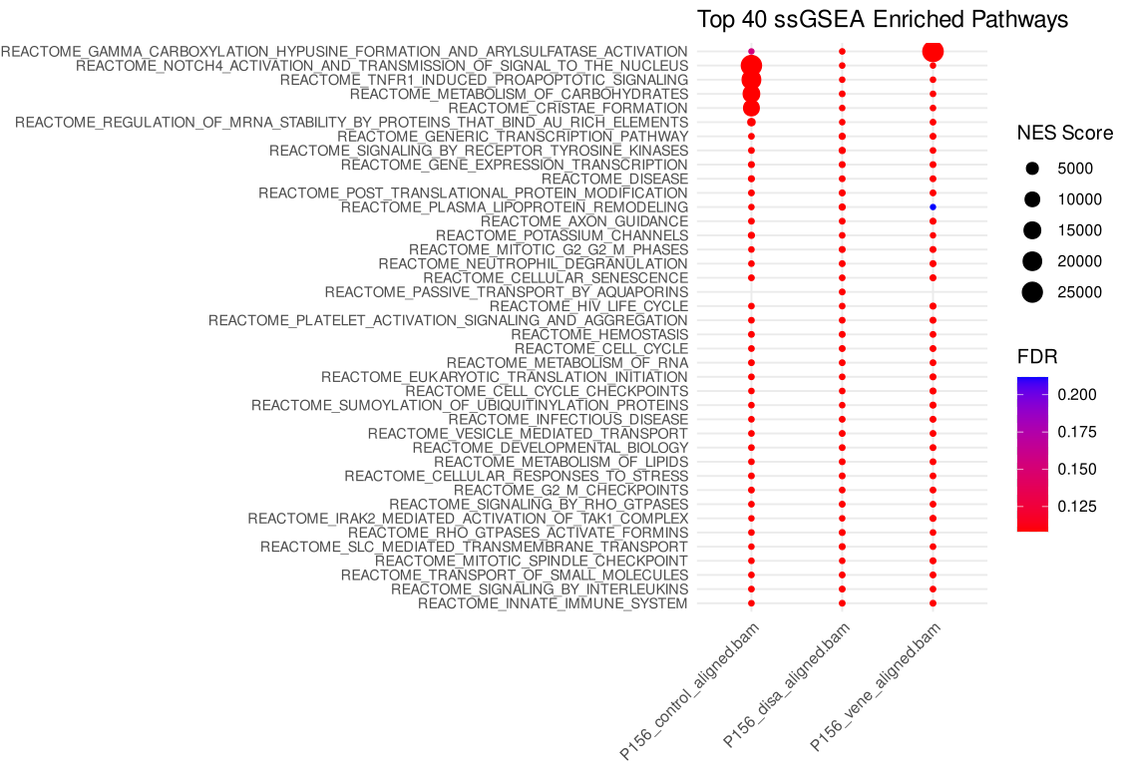
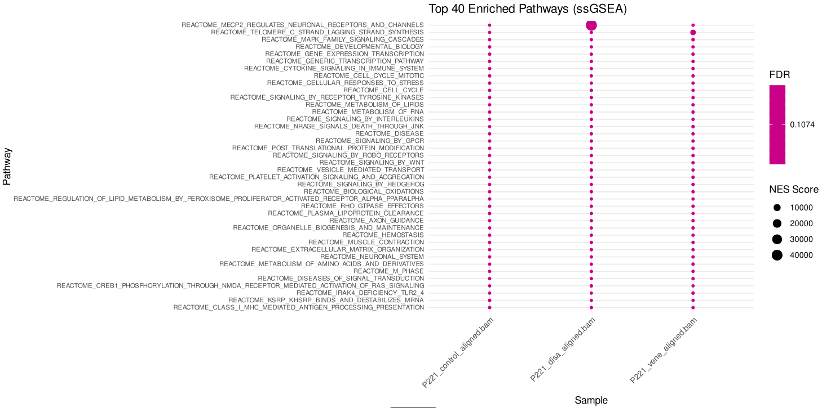
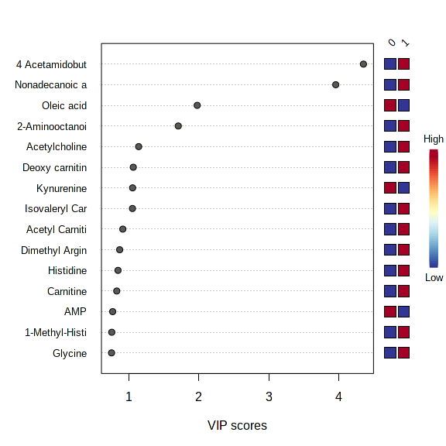
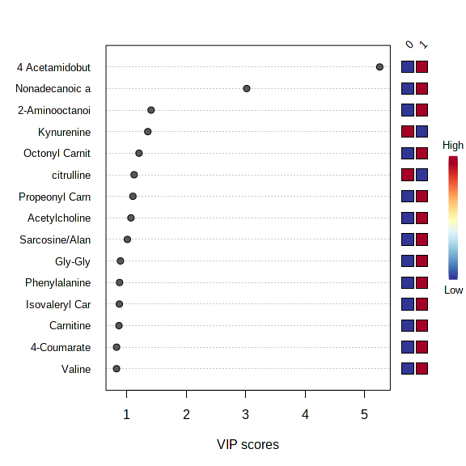
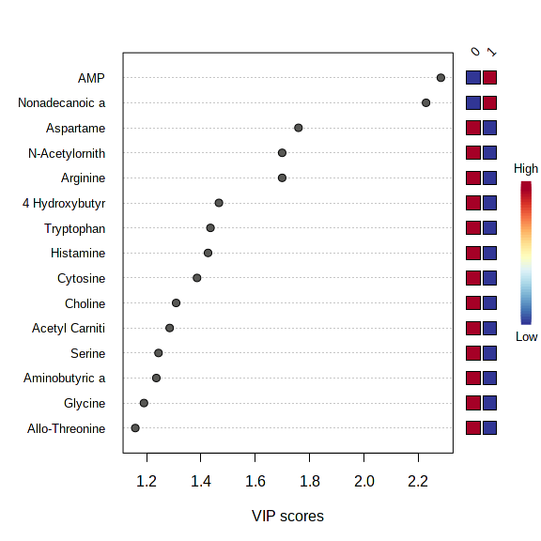
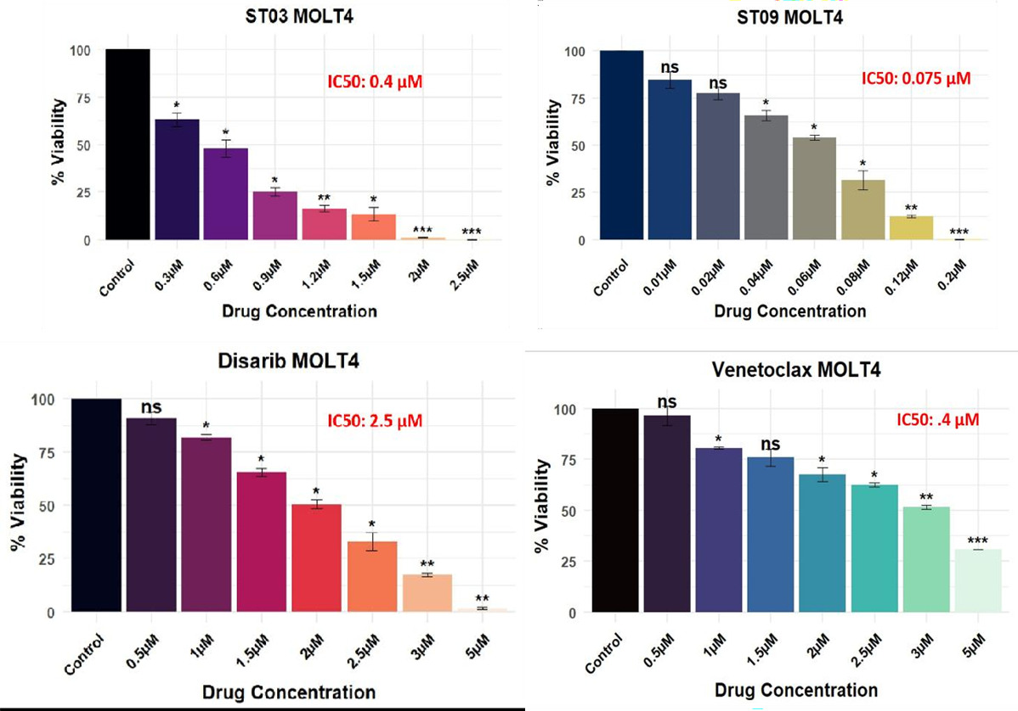
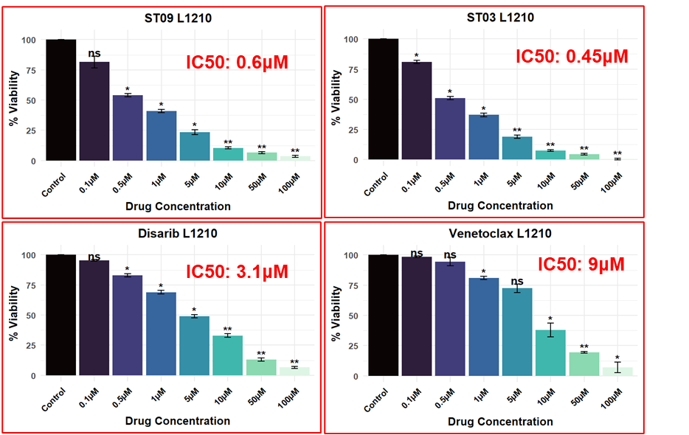
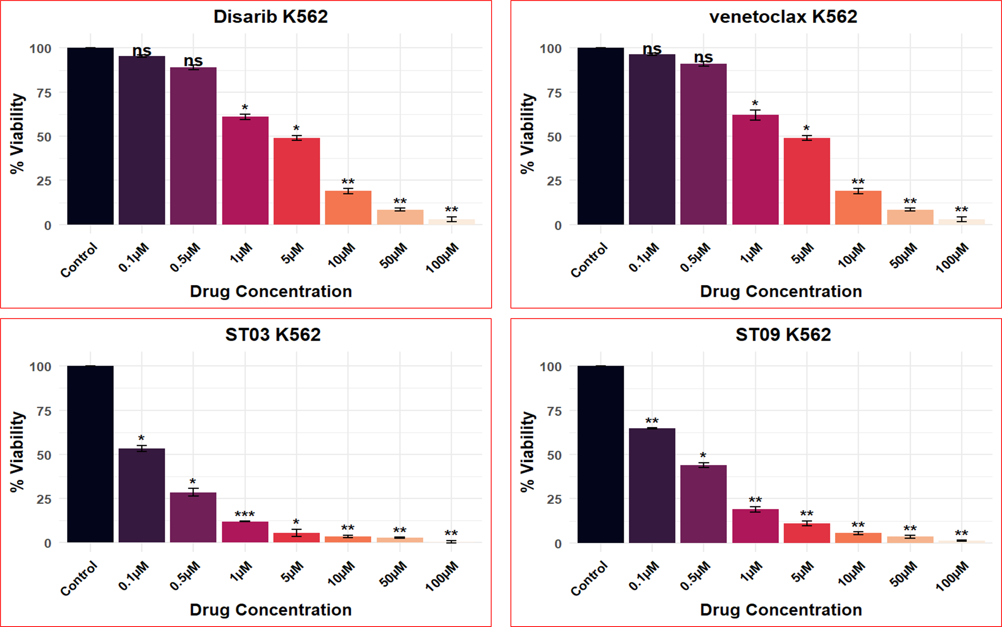
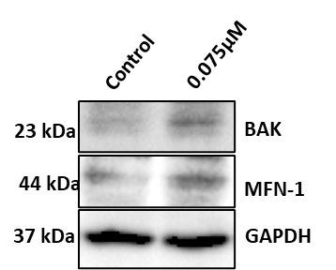
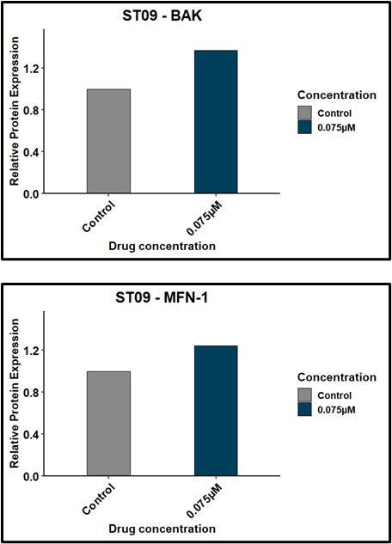
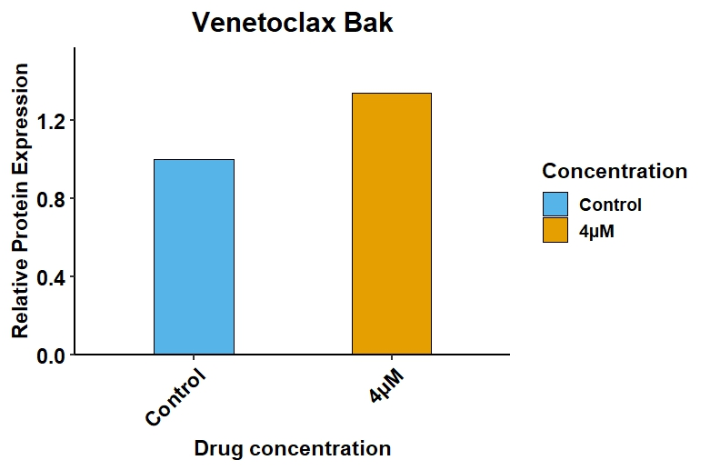
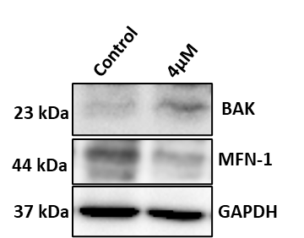
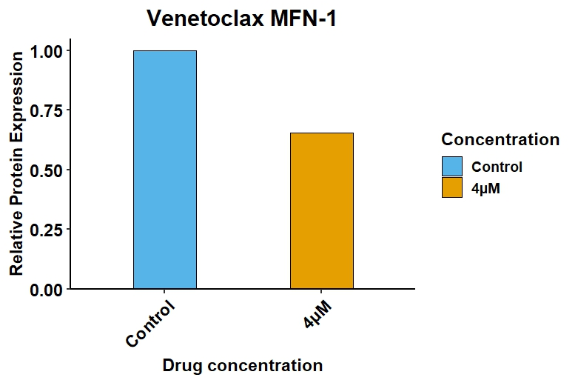
Mitochondrial Responses to BCL-2 Inhibitors in Hematological Cancer
Shyamjith P¹, Sagar S Desai², and Bibha Choudhary^{1*}
^{*1} Institute of Bioinformatics and Applied Biotechnology, Electronic City Phase 1,Bengaluru 560100
² Hematology Department, NCGM, Ahmedabad, Gujarat 380059
Abstract
Hematological Cancers
Methodology
Discussion
Leukemia, a hematological malignancy characterized by uncontrolled expansion of blast cells, frequently develops chemoresistance and relapse due to the survival of leukemic stem cells (LSCs). These LSCs adapt to therapeutic stress through mitochondrial reprogramming, marked by elevated oxidative phosphorylation (OxPhos), metabolic flexibility, and evasion of apoptosis. In this study, we examined the mitochondrial response of leukemia cells to BCL-2 inhibition using Venetoclax alongside in-house candidate compounds in cell lines. Integrated gene-expression profiling and functional assays revealed significant dysregulation of mitochondrial translation, apoptosis-related signalling, and OxPhos pathways following treatment. Transcriptomic analysis of patient samples from the TARGET-AML cohort identified key mitochondrial genes ACOT7 and AIFM2 that showed strong associations with overall survival. Expression-based patient stratification, supported by clustering, Kaplan-Meier survival curves, and ROC analyses, indicated that these genes may serve as clinically relevant prognostic markers. Molecular docking studies of ACOT7 and AIFM2 revealed high-affinity interactions between the in-house compounds and key functional domains regulating mitochondrial metabolism and cell-death pathways. Metabolomic profiling in the Dalton’s Lymphoma Ascites (DLA) model showed marked alterations in metabolites, consistent with mitochondrial rewiring observed across in vitro and in vivo systems. Overall, our multi-omics study points out mitochondrial metabolism as a critical determinant of treatment response and propose candidate biomarkers and therapeutic targets to improve personalized therapy for AML and Lymphoma patients.
Leukemia: Group of hematological malignancies originating in the bone marrow and blood.
Impairing normal hematopoiesis.
Venetoclax disrupts BCL-2–mediated apoptotic suppression, but its effectiveness depends on the mitochondrial metabolic state of leukemia cells.
Mitochondrial rewiring, including elevated OxPhos and altered mitochondrial translation, acts as a compensatory survival mechanism against BCL-2 inhibition.
Lymphoma: Cancer of the lymphatic system, primarily affecting lymph nodes, spleen, thymus, and bone marrow.
Two major categories: Hodgkin lymphoma (HL) and Non-Hodgkin lymphoma (NHL).
Leukemia and lymphoma account for ~3–4% of all cancers worldwide, with leukemia causing ~474,500 new cases and 311,500 deaths annually.
Conclusion
Mitochondrial gene signatures stratify AML patients into distinct prognostic groups.ACOT7 and AIFM2 emerged as strong predictors of patient survival.
Kaplan–Meier analyses validated their prognostic value.
Docking studies with known inhibitors and in-house compounds revealed promising therapeutic interactions.
In-house drug candidates showed comparable or stronger docking affinity, indicating potential novel therapeutics.
Introduction
Mitochondria play a central role in regulating energy production, apoptosis, and metabolic adaptation in hematological cancers. Leukemic and lymphoma cells frequently develop therapeutic resistance by rewiring mitochondrial pathways, increasing oxidative phosphorylation (OxPhos), and suppressing cell-death signalling. BCL-2 inhibitors, such as Venetoclax, target mitochondrial apoptotic machinery by disrupting BCL-2–mediated sequestration of pro-apoptotic proteins. However, treatment responses vary widely due to mitochondrial heterogeneity and compensatory survival mechanisms within malignant cells. Understanding how mitochondria functionally and transcriptionally respond to BCL-2 inhibition is therefore essential for improving therapeutic efficacy.
Reference
1. S. B. Panina, J. Pei, and N. V. Kirienko, “Mitochondrial metabolism as a target for acute myeloid leukemia treatment,” Cancer & Metabolism, vol. 9, no. 1, Apr. 2021, doi: 10.1186/s40170-021-00253-w.
2. A. Zhang, W. Liu, and S. Qiu, “Mgenetic variations in leukemia: a comprehensive overview,” Blood Science, vol. 6, no. itochondrial 4, p. e00205, Sep. 2024, doi: 10.1097/bs9.0000000000000205.
Results
Clustering Reveals Mitochondrial Signatures and Survival Prediction Through Mitochondrial Gene Clusters
In Silico Docking of ACOT7 & AIFM2
Transcriptomic profiling and Metabolite analysis of Dalton’s Lymphoma Ascites & treated with Disarib
Univariate analysis of normal vs DLA tumour control
Timepoint | Total | Significant
Start point | 61 | 56
Mid point | 61 | 49
End point | 61 | 44
 | Orlistat ΔG (kcal/mol) | Orlistat Ki (µM) | ST09 ΔG (kcal/mol) | ST09 Ki (µM) | ST03 ΔG (kcal/mol) | ST03 Ki (µM)
ACOT7 | -7.2 | 4.4 | -7.3 | 4.5 | -7.8 | 1.9
AIFM2 | -6.8 | 10.5 | -9.8 | 0.066 | -9.7 | 0.08
Univariate analysis of tumour control vs Disarib treatment
Start point
Mid point
End point
Timepoint | Total | Significant
Start point | 61 | 36
Mid point | 61 | 3
End point | 61 | 44

Slide 2




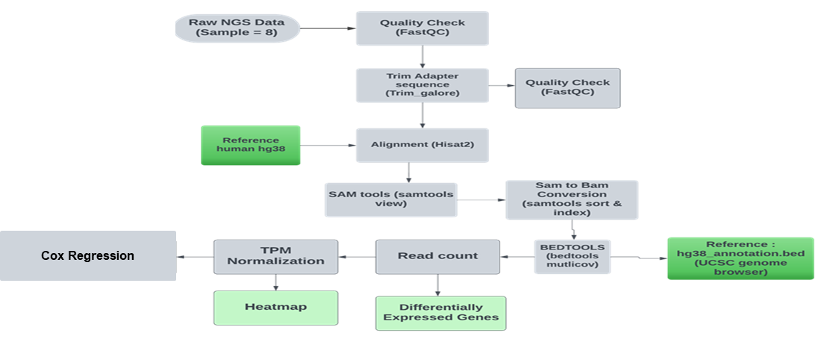
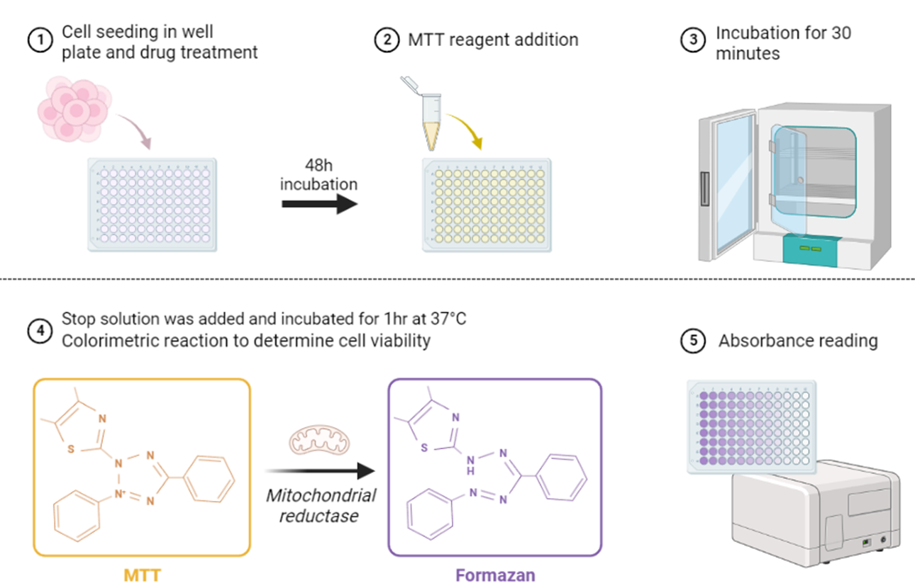
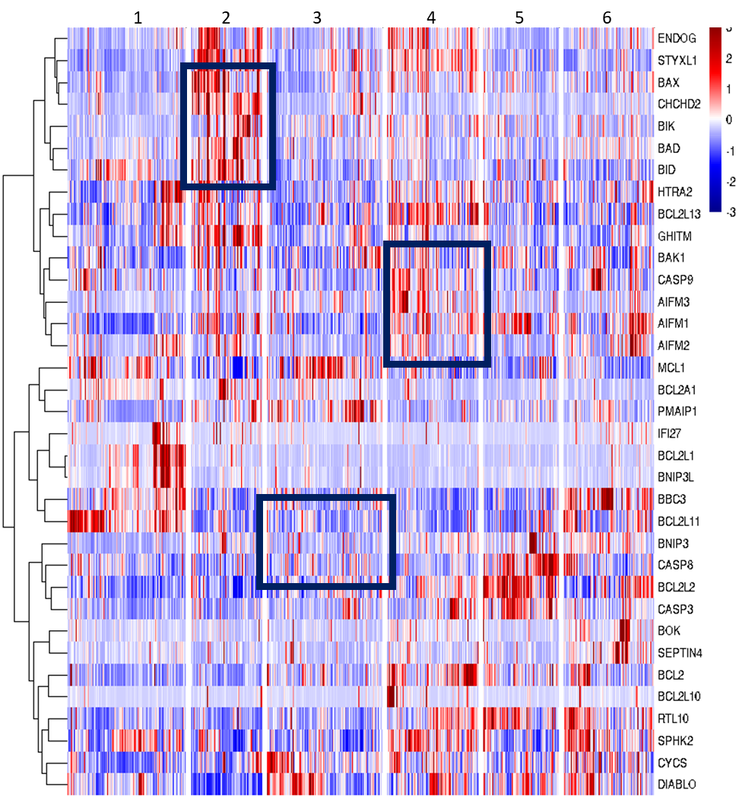
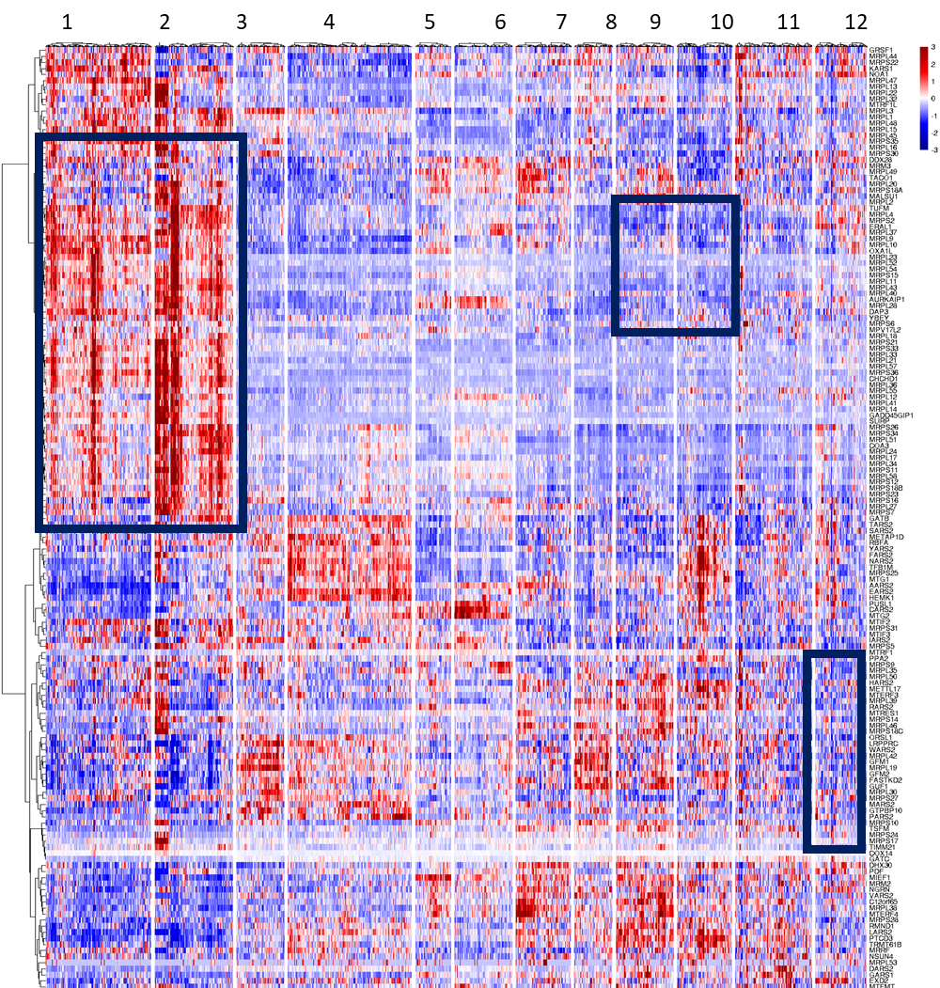
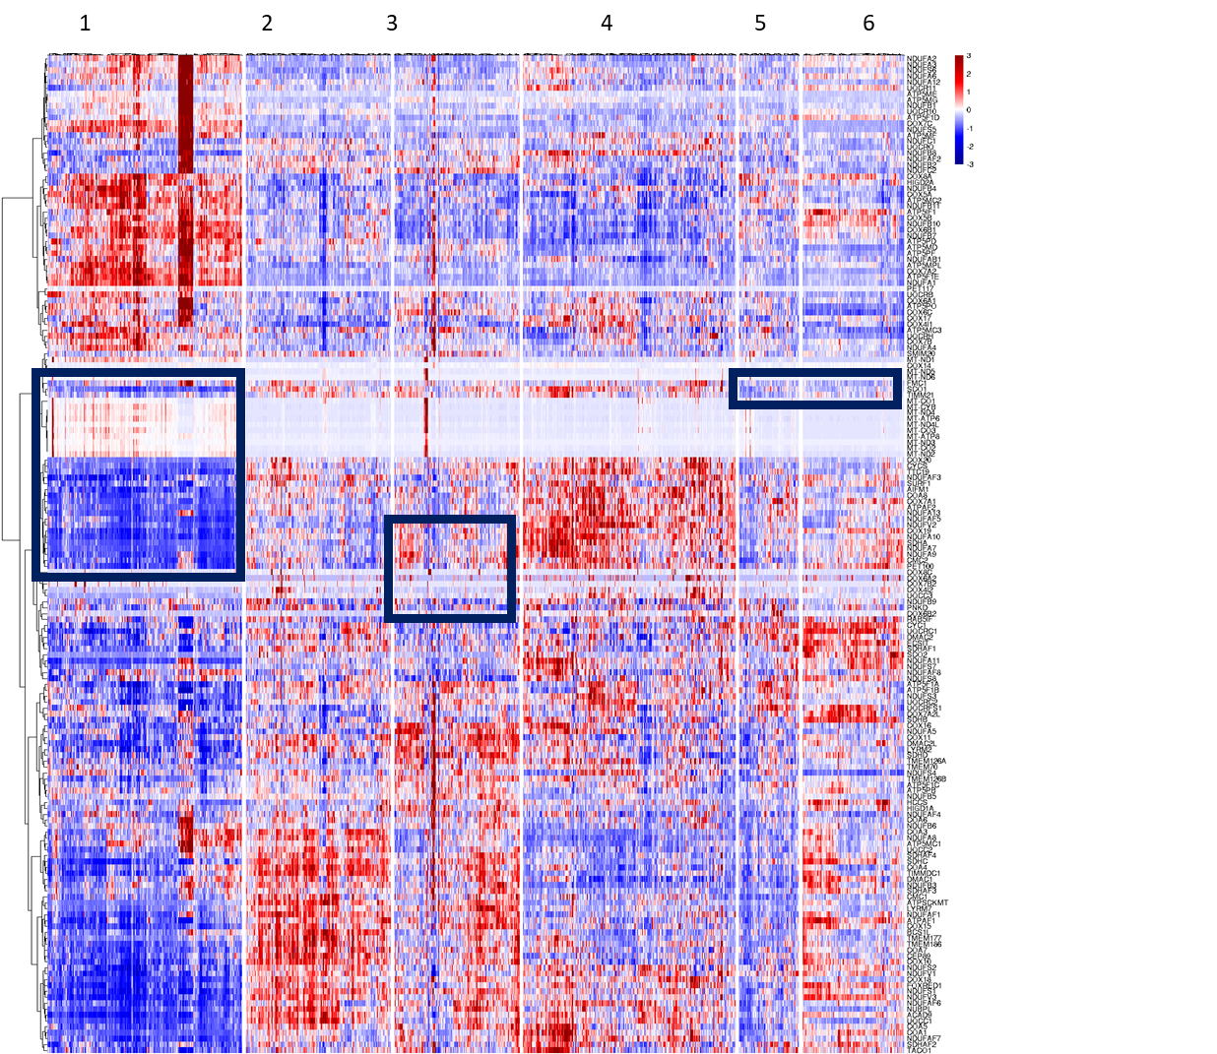
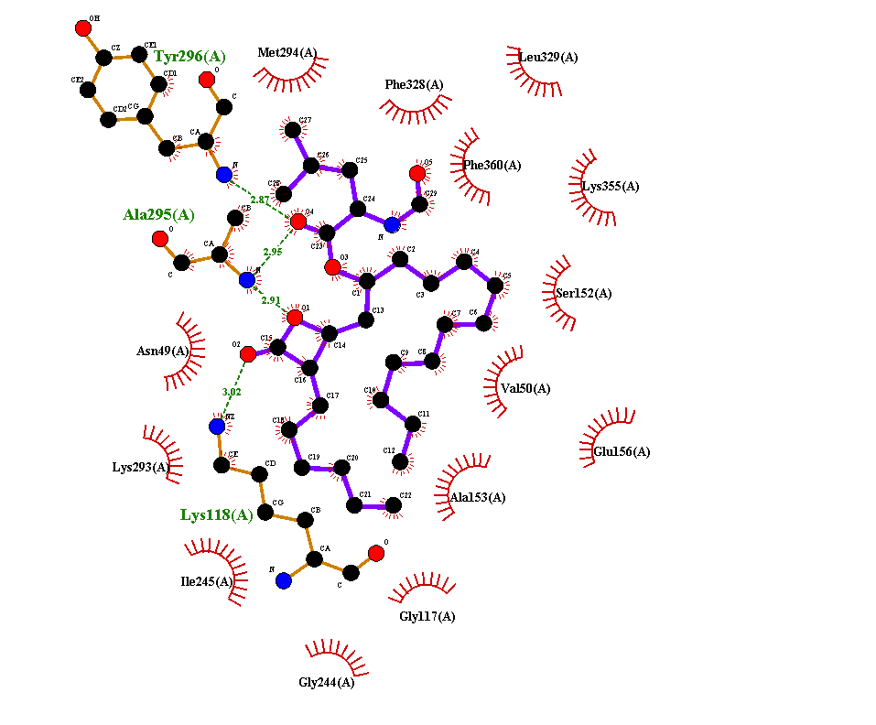
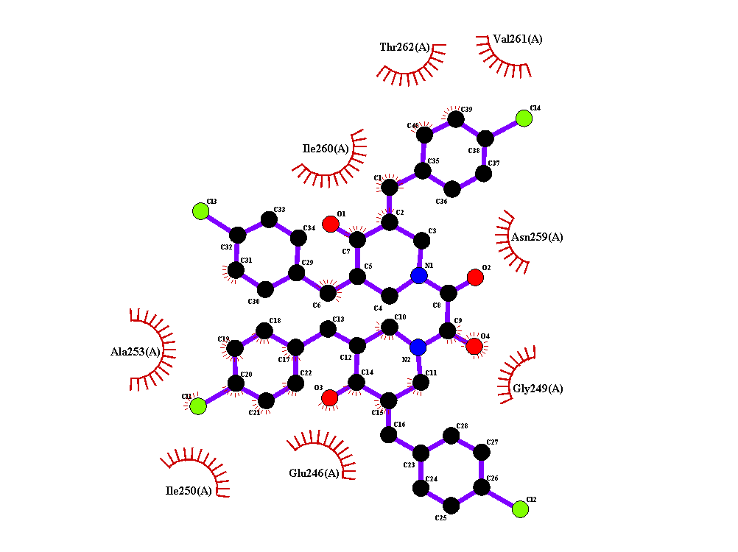
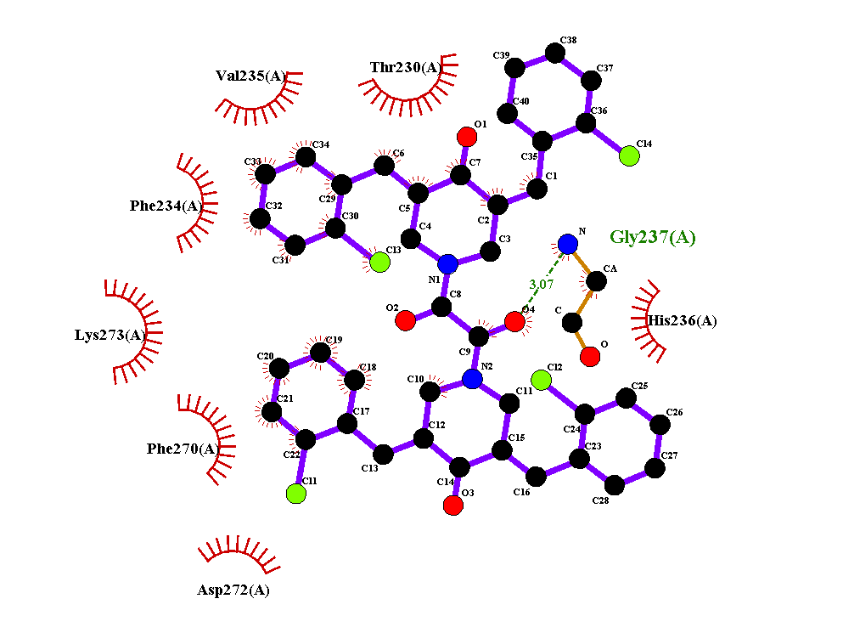
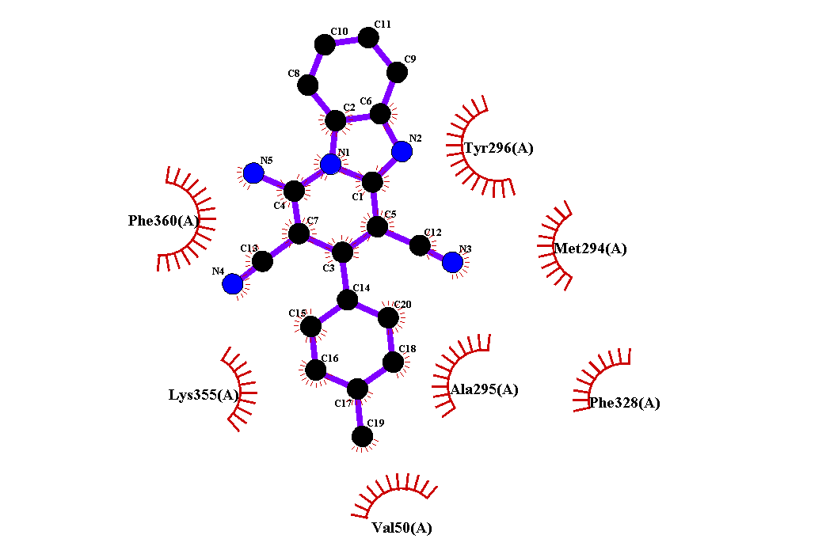
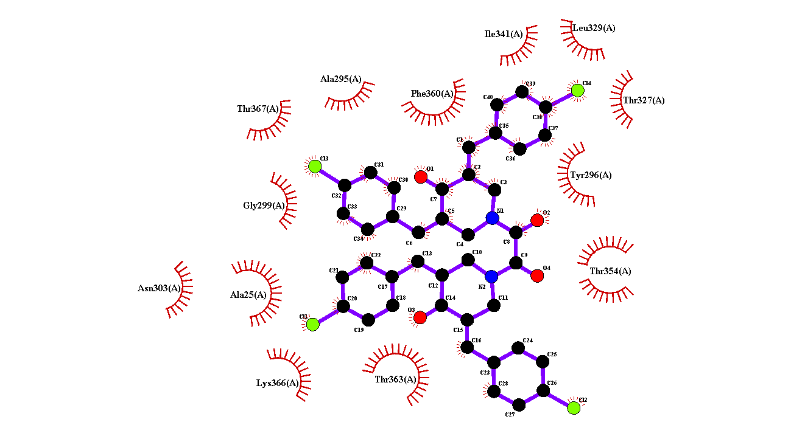
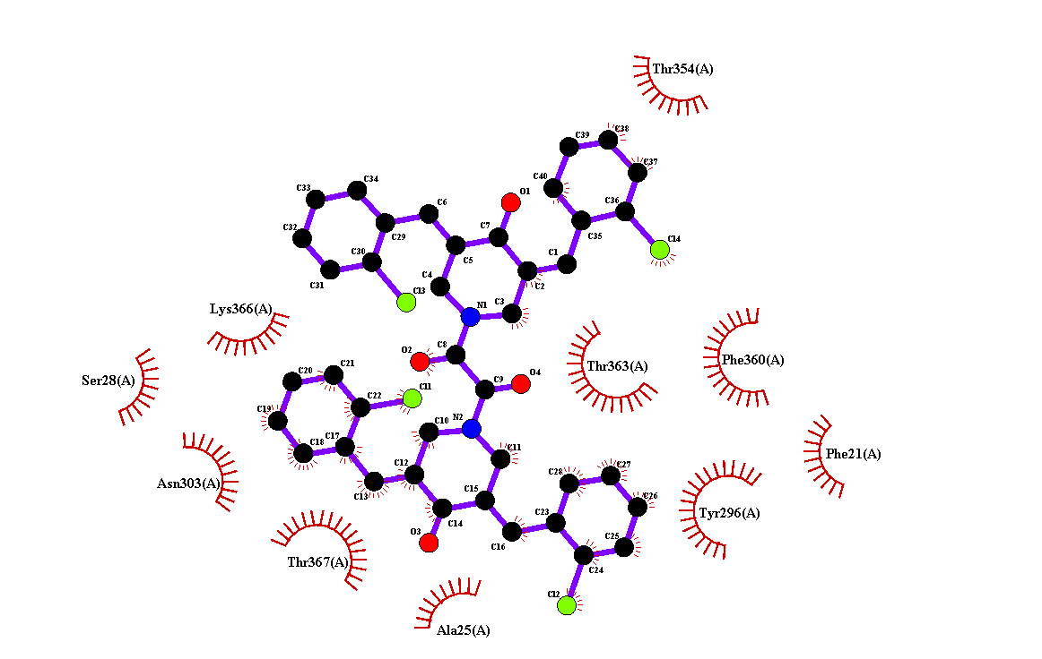
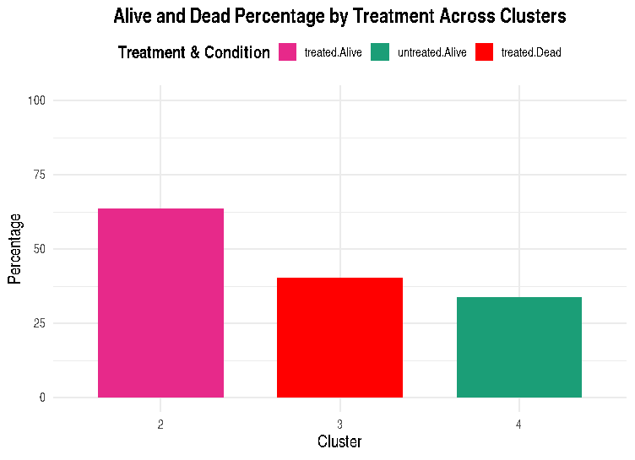
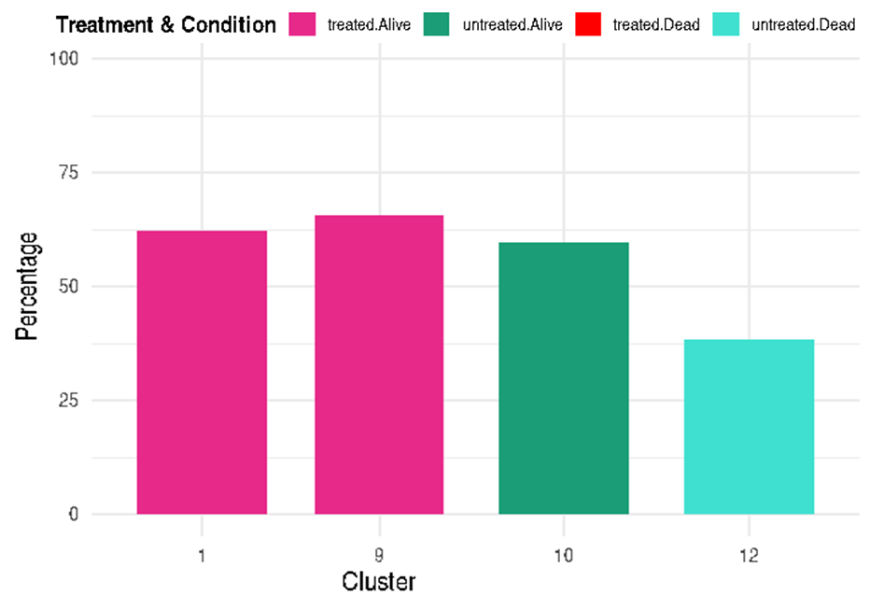
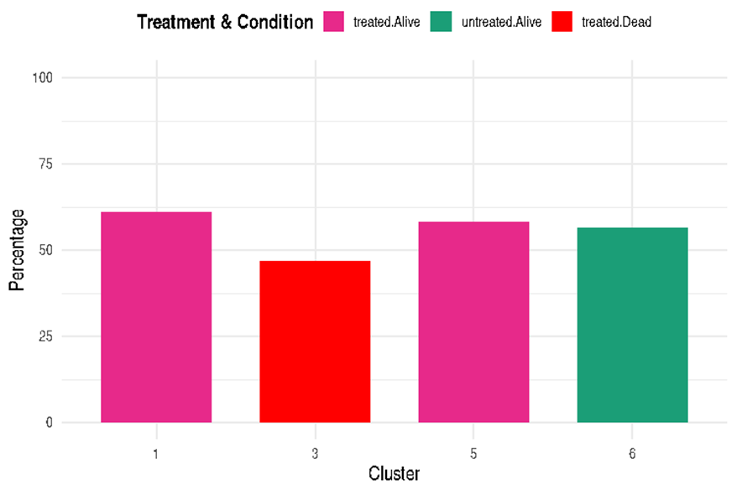
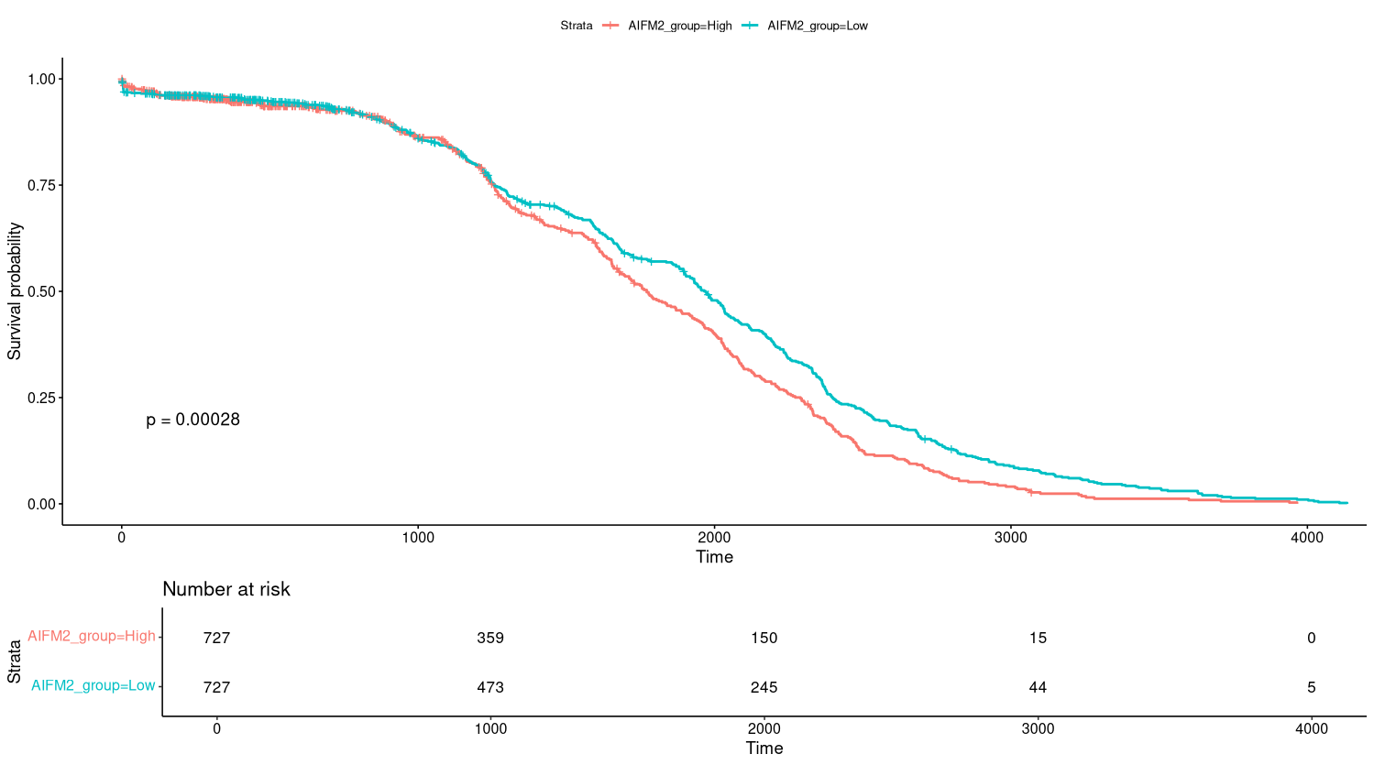
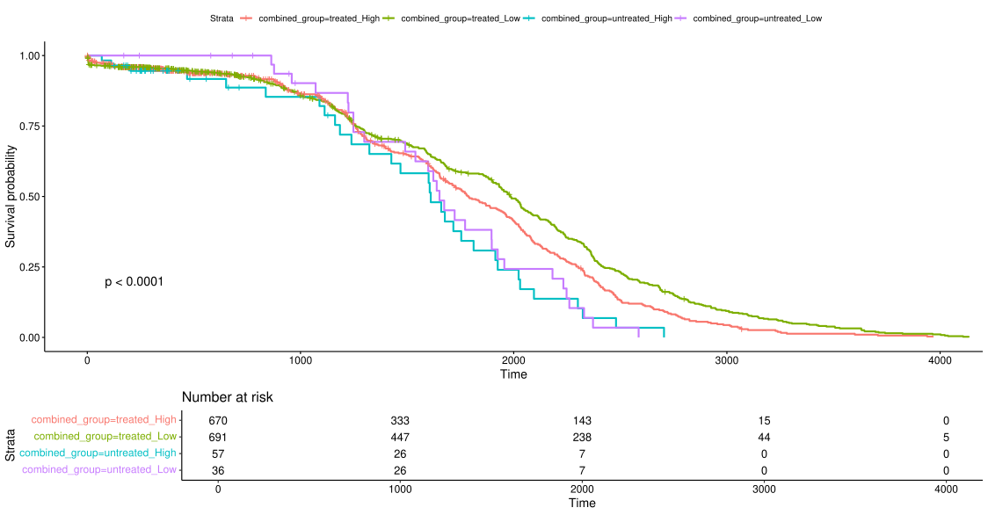
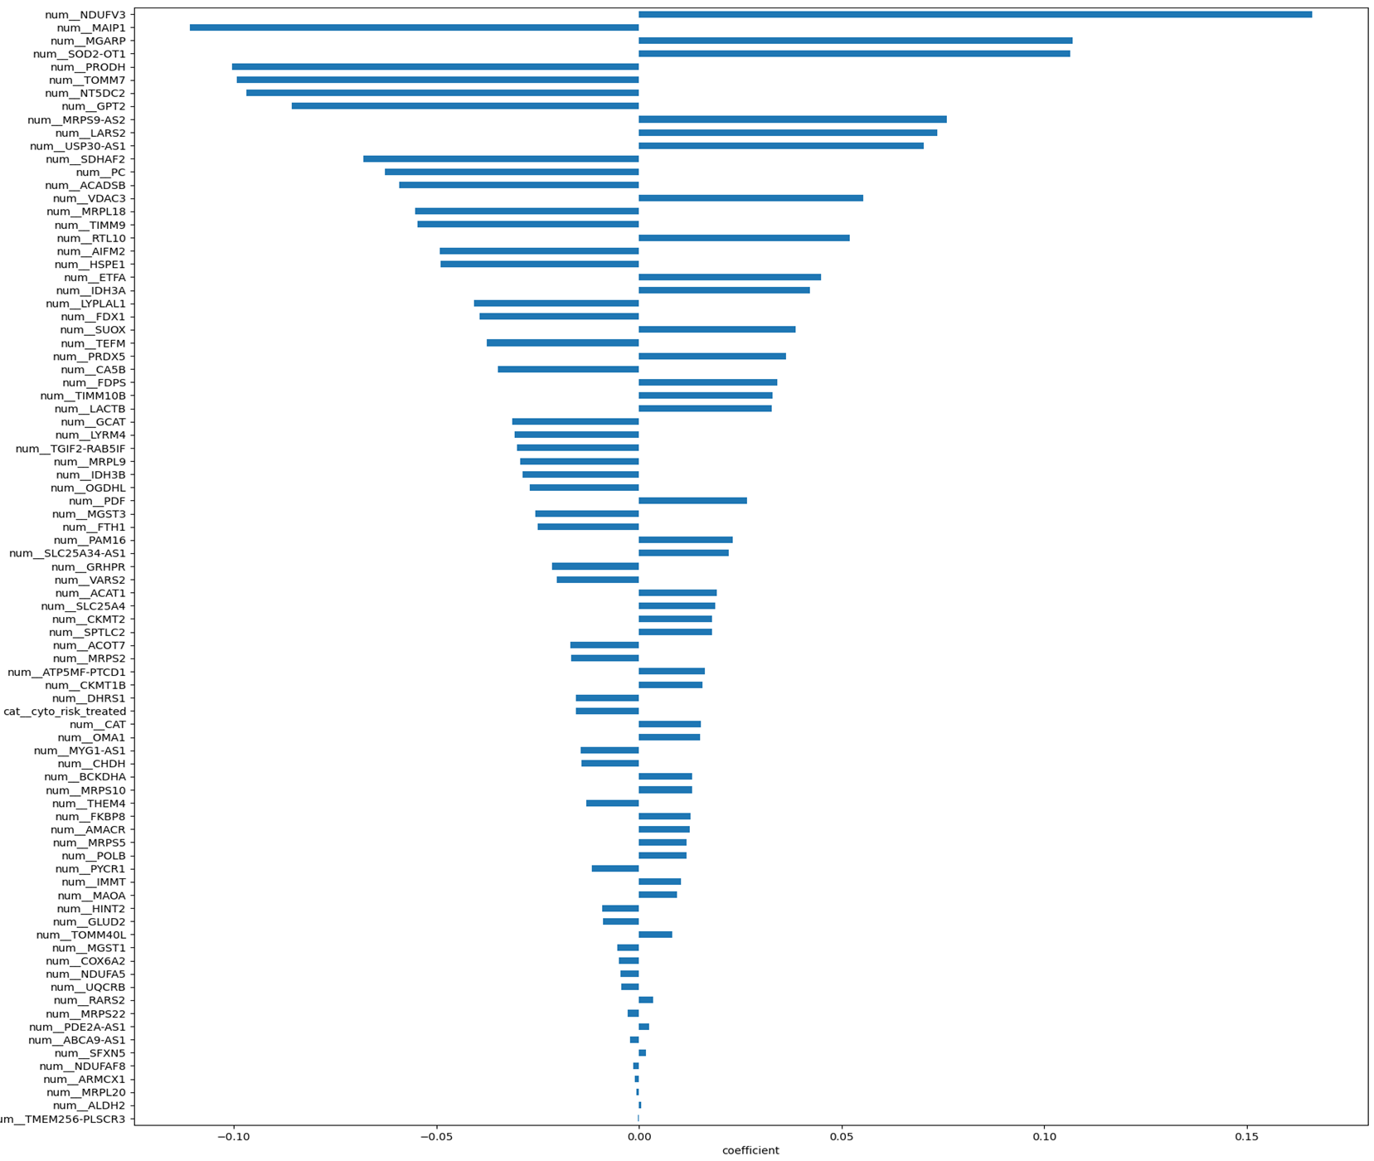
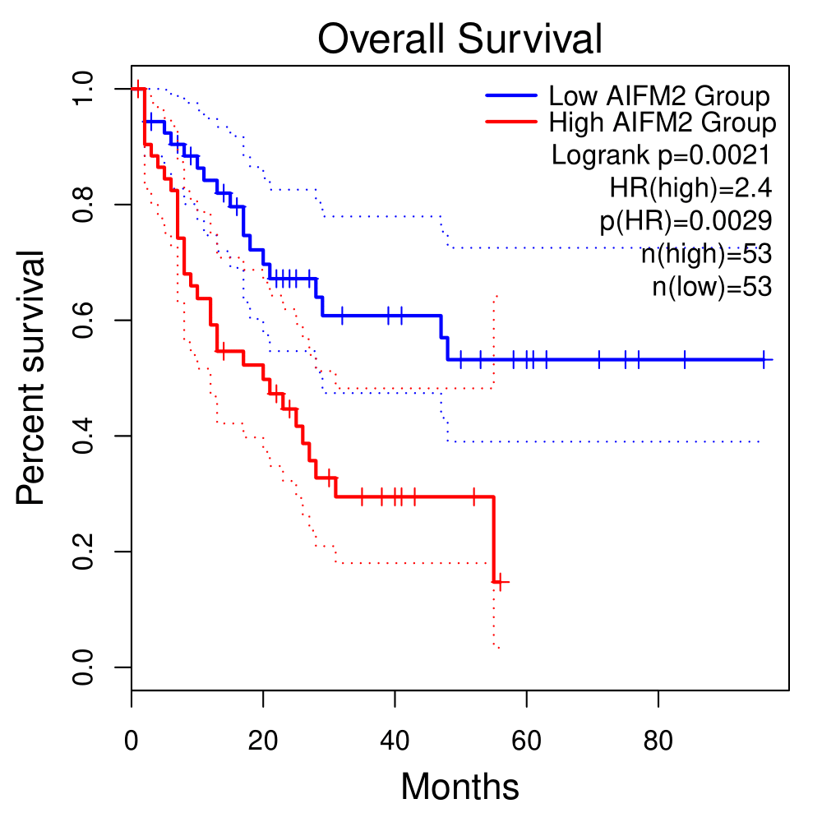
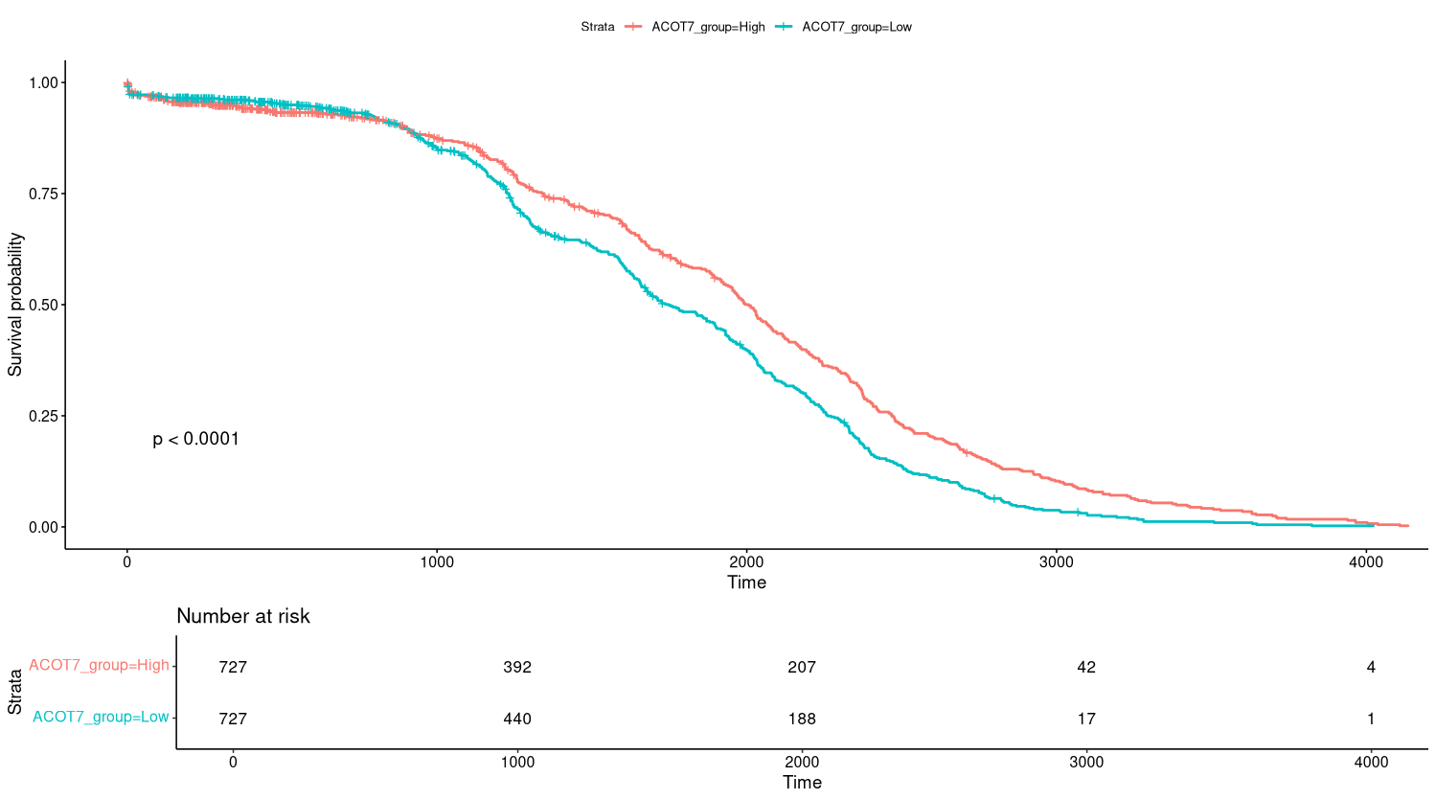
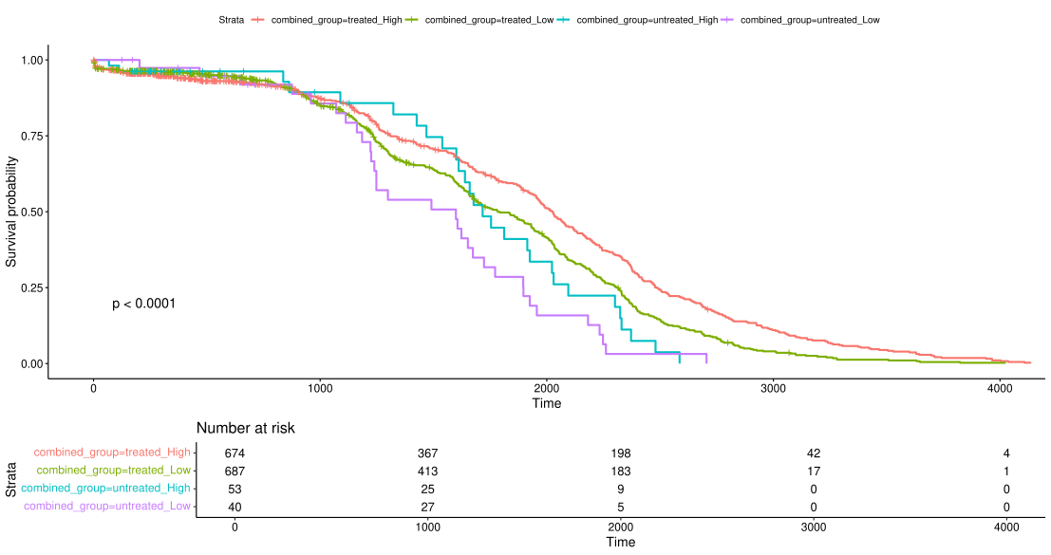










Mitochondrial Responses to BCL-2 Inhibitors in Hematological Cancer
Shyamjith P¹, Sagar S Desai¹, and Bibha Choudhary^{1*}
^{*1} Institute of Bioinformatics and Applied Biotechnology, Electronic City Phase 1,Bengaluru 560100
Abstract
Hematological Cancers: Leukemia and Lymphoma
The Role of BCL-2 Inhibitor in Hematological Malignancies
Leukemia, a hematological malignancy characterized by uncontrolled proliferation of blast cells, often exhibits chemoresistance and relapse, driven largely by leukemic stem cells, LSCs. These LSCs adapt to therapeutic stress through mitochondrial reprogramming, which enhances oxidative phosphorylation, OxPhos, and evades apoptosis. This study explores the mitochondrial response to BCL-2 inhibition using Venetoclax and in-house drugs in leukemia cell lines. Gene expression and functional assays revealed dysregulation in mitochondrial translation, apoptosis, and oxidative phosphorylation, - related pathways. Transcriptomic analysis of AML patient data from the TARGET-AML study identified mitochondrial genes significantly associated with patient survival, including ACOT7 and AIFM2. Stratification based on mitochondrial gene expression revealed potential prognostic subgroups, supported by clustering, survival, and ROC analyses. Our findings highlight mitochondrial metabolism as a critical determinant of treatment response and propose candidate biomarkers and therapeutic targets to improve personalized therapy for AML patients.
Leukemia: Group of hematological malignancies originating in the bone marrow and blood.
Characterized by uncontrolled proliferation of abnormal white blood cells, impairing normal hematopoiesis.
Lymphoma: Cancer of the lymphatic system, primarily affecting lymph nodes, spleen, thymus, and bone marrow.
Results from malignant transformation of B or T lymphocytes.
Two major categories: Hodgkin lymphoma (HL) and Non-Hodgkin lymphoma (NHL).
Leukemia and lymphoma account for ~3–4% of all cancers worldwide, with leukemia causing ~474,500 new cases and 311,500 deaths annually. Non-Hodgkin lymphoma is more common, contributing ~544,000 new cases and 259,000 deaths, while Hodgkin lymphoma adds ~83,000 cases and 23,000 deaths each year.
Mitochondria regulate apoptosis through the intrinsic/extrinsic pathway.
Release of cytochrome c and other pro-apoptotic factors triggers caspase activation → cell death.
Hematological malignancies often show mitochondrial reprogramming to support high energy and biosynthetic needs.
Altered TCA cycle, OXPHOS, and FAO pathways contribute to survival, proliferation, and drug resistance.
Balance between pro-apoptotic (BAX, BAK) and anti-apoptotic (BCL-2, MCL-1) proteins at the mitochondrial outer membrane decides cell fate.
BCL-2 inhibitors: Bind to the BH3-binding groove of BCL-2.
Displace pro-apoptotic proteins (BIM, PUMA, BID).
Promote MOMP (Mitochondrial Outer Membrane Permeabilization).
Trigger cytochrome c release → caspase cascade → apoptosis.
Mechanism of resistance:
Upregulation of Other Anti-Apoptotic Proteins
Genetic Mutations
Metabolic Adaptations
Clonal Evolution
METHODOLOGY
Conclusion
Reference
1. RNA-Seq Analysis
2. Cytotoxicity Evaluation
3. Protein isolation - Western blotting
Mitochondrial gene signatures stratify AML patients into distinct prognostic groups.ACOT7 and AIFM2 emerged as strong predictors of patient survival.
Kaplan–Meier analyses validated their prognostic value.
Docking studies with known inhibitors and in-house compounds revealed promising therapeutic interactions.
In-house drug candidates showed comparable or stronger docking affinity, indicating potential novel therapeutics.
Targeting mitochondrial regulators may offer novel strategies for precision therapy in hematological cancers.
1. S. B. Panina, J. Pei, and N. V. Kirienko, “Mitochondrial metabolism as a target for acute myeloid leukemia treatment,” Cancer & Metabolism, vol. 9, no. 1, Apr. 2021, doi: 10.1186/s40170-021-00253-w.
2. A. Zhang, W. Liu, and S. Qiu, “Mitochondrial genetic variations in leukemia: a comprehensive overview,” Blood Science, vol. 6, no. 4, p. e00205, Sep. 2024, doi: 10.1097/bs9.0000000000000205.
3. S. Wu, M. Akhtari, and H. Alachkar, “Characterization of mutations in the mitochondrial encoded electron transport chain complexes in acute myeloid leukemia,” Scientific Reports, vol. 8, no. 1, Aug. 2018, doi: 10.1038/s41598-018-31489-0.
4. I. Czegle, A. L. Gray, M. Wang, Y. Liu, J. Wang, and E. A. Wappler-Guzzetta, “Mitochondria and Their Relationship with Common Genetic Abnormalities in Hematologic Malignancies,” Life, vol. 11, no. 12, p. 1351, Dec. 2021, doi: 10.3390/life11121351.
RESULTS
Clustering Reveals Mitochondrial Signatures and Survival Prediction Through Mitochondrial Gene Clusters
In Silico Docking of ACOT7 & AIFM2
A
Apoptotic Pathway genes
B
Mitochondrial Translation genes
C
OXPHOS Pathway genes
A
ACOT7-Orlistat
ACOT7-ST09
ACOT7-ST03
B
AIFM2-Orlistat
AIFM2—ST09
AIFM2—ST03
A- Heatmap of expression profile of apoptosis genes from TARGET-AML study dataset
B - Heatmap of expression profile of OxPhos genes from TARGET-AML study dataset
C - Heatmap of expression profile of mitochondrial translation genes from TARGET-AML study dataset
C
 | Orlistat ΔG (kcal/mol) | Orlistat Ki (µM) | ST09 ΔG (kcal/mol) | ST09 Ki (µM) | ST03 ΔG (kcal/mol) | ST03 Ki (µM)
ACOT7 | -7.2 | 4.4 | -7.3 | 4.5 | -7.8 | 1.9
AIFM2 | -6.8 | 10.5 | -9.8 | 0.066 | -9.7 | 0.08
C
D
E
A,B - In Silico Docking of ACOT7 & AIFM2 with Orlistat, ST09 & ST03
C - In silico inhibitory activity of Orlistat , ST09 and ST03
A
Mitochondrial and Metabolic Gene Alterations in Primary AML and CEM Cells Treated with BCL-2 Inhibitors- Disarib & Venetoclax
C- Kaplan-Meier survival plot for ACOT7 and AIFM2 from TARGET-AML patient data
D- COX regression model for genes with high/low hazard ratios influencing patient survival
E - Survival plot for ACOT7 and AIFM2 in AML (right)
B
Transcriptomic profiling and Metabolite analysis of Dalton’s Lymphoma Ascites & treated with Disarib
A
Univariate analysis of normal vs DLA tumour control
Univariate analysis of tumour control vs Disarib treatment
Normal vs DLA tumour control metabolite information
C
Timepoint | Total | Significant
Start point | 61 | 56
Mid point | 61 | 49
End point | 61 | 44
B
Tumour control vs Disarib treatment metaboilite information
C
Timepoint | Total | Significant
Start point | 61 | 36
Mid point | 61 | 3
End point | 61 | 44
D
A- Normal vs DLA tumour control metabolite information
B - Multivariate analysis of normal vs DLA tumour control
C – Tumour control vs Disarib treatment metaboilite information
D- Multivariate analysis of tumourcontrol vs Disarib treated
A- BCL-2 family gene, TCA, Oxphos gene expression in CEM cells
B- BCL-2 family gene, TCA, Oxphos gene expression in primary patient cells
C- ssGSEA enriched path for all
A
B
C
ST09
D
A- Cytotoxicty evaluation in MOLT4 cells
B- Cytotoxicty evaluation in L1210 cells
C- Cytotoxicty evaluation in K562 cells
D,E – Protein expression from MOLT4-Treated cells
Venetoclax
E
Acknowledgement
We thank the Dept. of Science & Technology (SR/FST/LSI-536/2012), the Depts. of Information Technology, Biotechnology, and Science & Technology, Government of Karnataka, India and DBT-BUILDER (BT/INF/2022/SP45402/2022

Slide 3




Hematological Cancers: Leukemia and Lymphoma
Sample Processing
Computational Analysis
Structural Analysis
Interpretation
Univariate analysis of tumour control vs Disarib treatment
Start point
Mid point
Univariate analysis of normal vs DLA tumour control
End point
Start point
Mid point
End point
Timepoint | Total | Significant
Start point | 61 | 36
Mid point | 61 | 3
End point | 61 | 44

